Slide 1
3강 - JSP, MVC패턴
JAVA 웹 개발자 양성과정Spring: Spring MVC
By SoonGu Hong

Slide 2
1. JSP
JAVA 웹 개발자 양성과정
Spring: Spring MVC

Slide 3
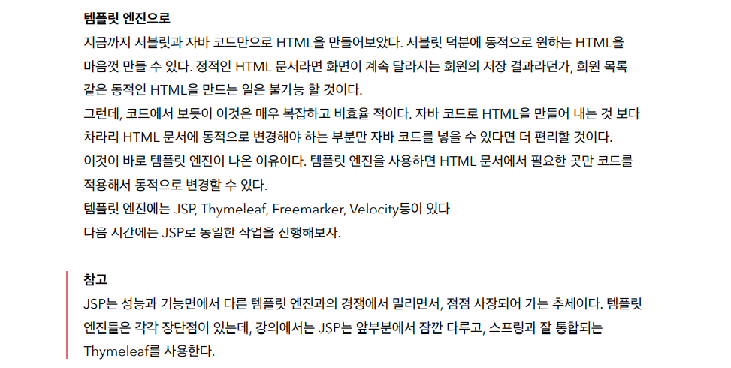

Slide 4
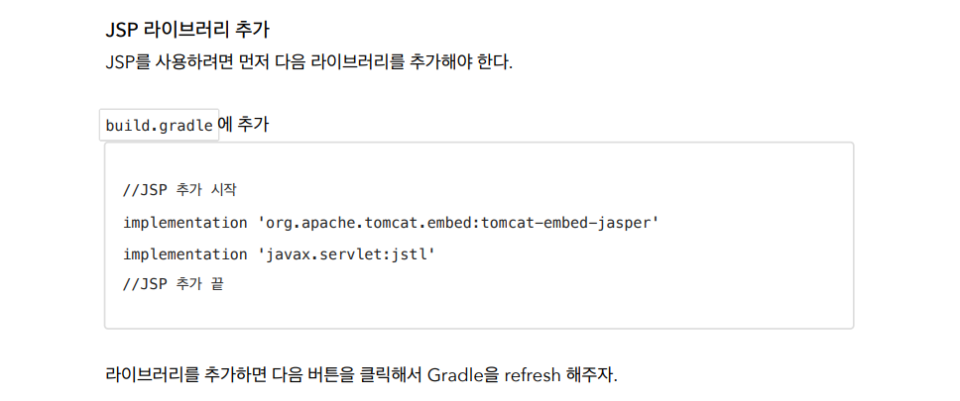
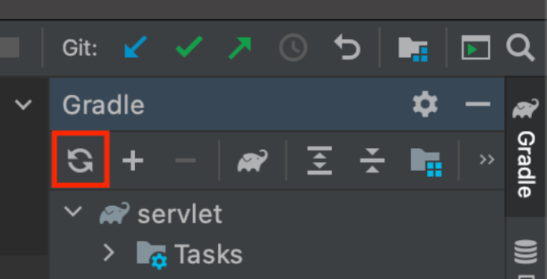

Slide 5
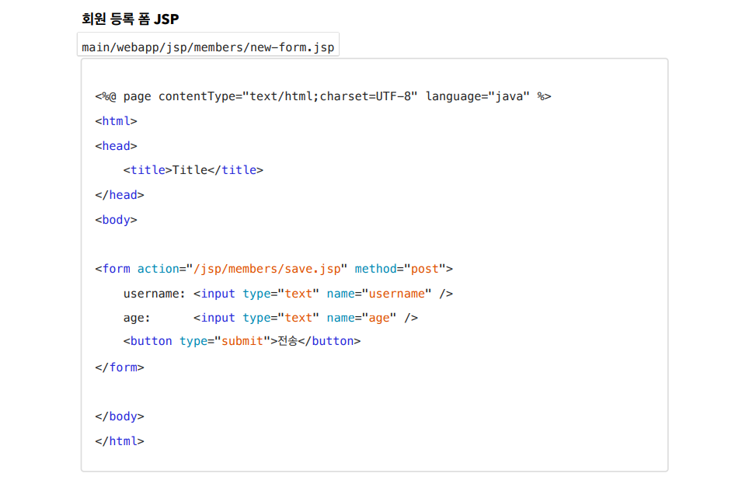

Slide 6
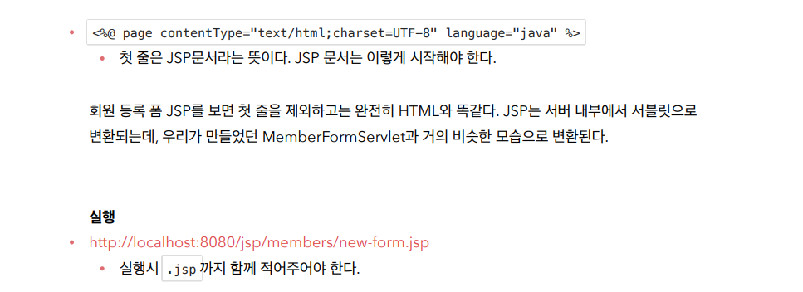

Slide 7


Slide 8



Slide 9
2. MVC 패턴
JAVA 웹 개발자 양성과정
Spring: Spring MVC

Slide 10
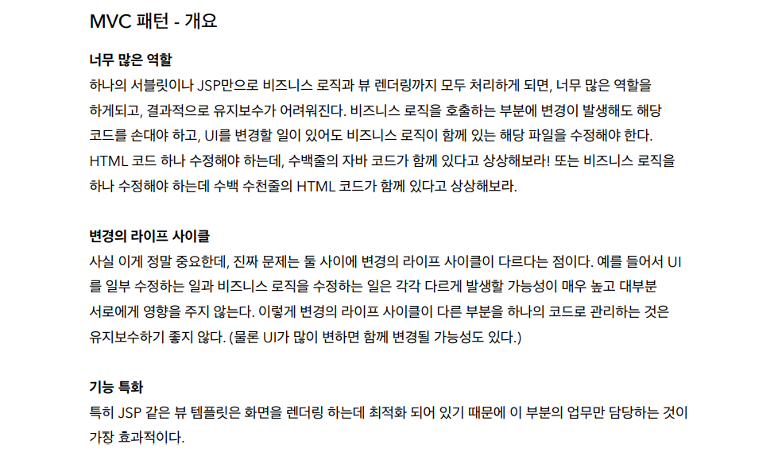

Slide 11



Slide 12
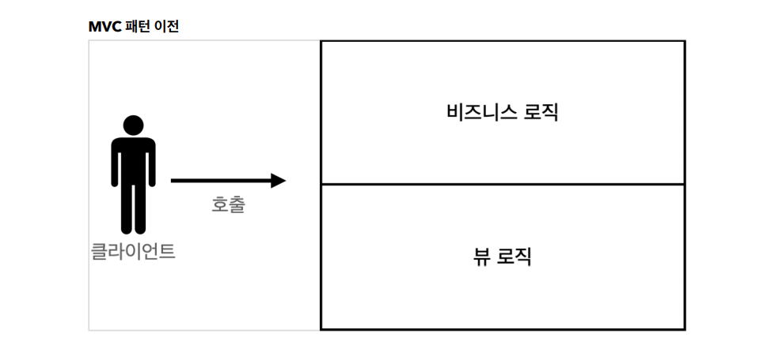

Slide 13
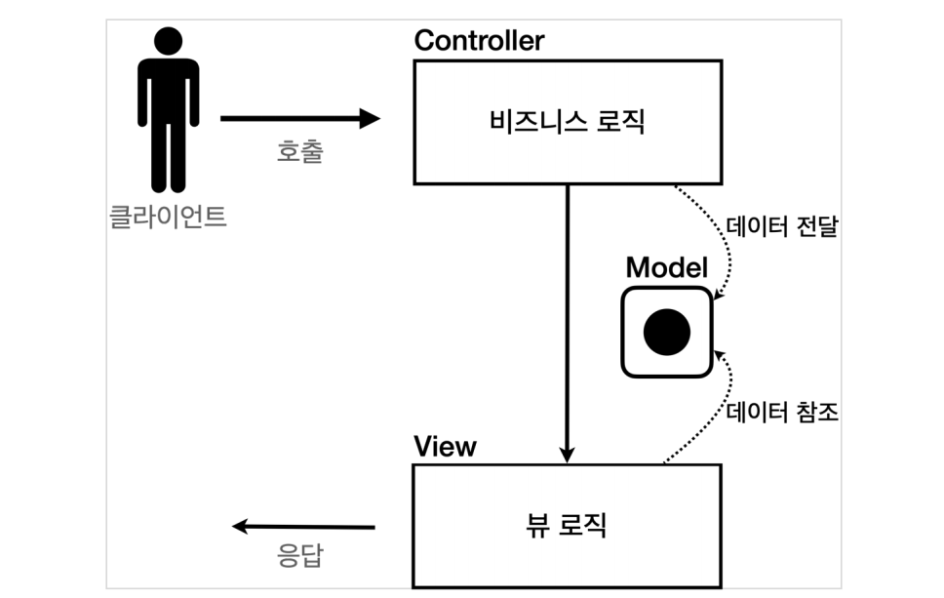

Slide 14
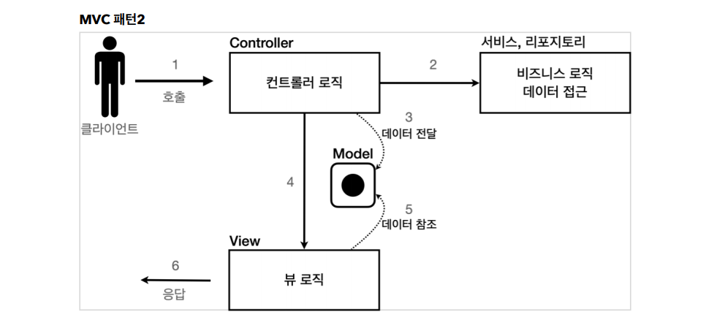

Slide 15



Slide 16


Slide 17


Slide 18
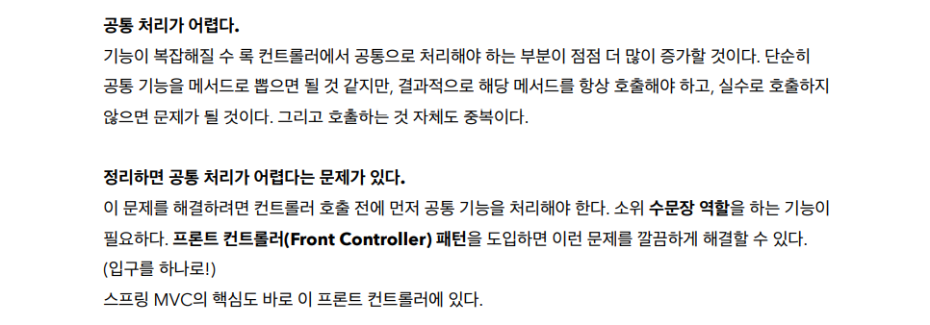

Slide 19
감사합니다
THANK YOU

